Slide 1
FRAMEWORK’s
Reusable Systems
Name- Ritanshu Mahajan
Reg No- 25MCA10077

Slide 2
What is Framework?
A framework is a structured blueprint that guides thinking, decision-making, and execution. It helps organize complex problems into repeatable patterns so teams can align, act consistently, and measure progress.

Slide 3
Horizontal & Vertical Framework
Aspect | Horizontal framework | Vertical framework
Structure | Flat or few layers; cross-functional teams with broad responsibilities. | Multi-tiered hierarchy; clear command lines from top to bottom.
Decision-making | Decentralized; teams often decide locally without heavy approvals. | Centralized through managers; decisions flow upward for sign-off.
Communication flow | Open, lateral communication across functions for quick alignment. | Downward and upward channels; messages pass through several layers.
Agility and speed | Generally faster execution and experimentation within teams. | Can be slower due to bureaucracy and gatekeeping.
Accountability | Shared ownership within self-managed groups. | Individual accountability mapped to formal roles and reporting lines.

Slide 4
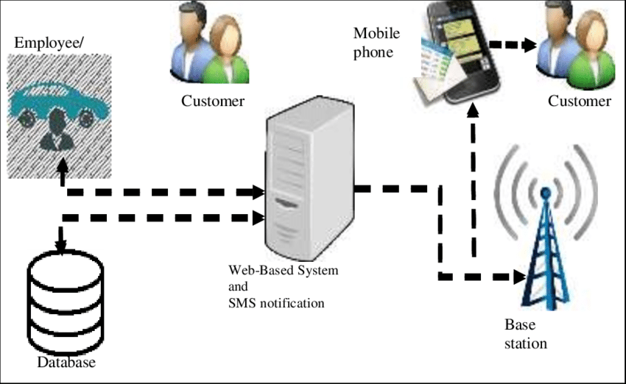
Car Rental System Framework
Horizontal framework
  Structure and responsibilities: Cross-functional, autonomous teams own end-to-end customer journeys (booking, payment, fleet availability) across shared processes.
  Decision-making and control: Local teams make domain-specific decisions, enabling rapid responses to daily operations.
Vertical framework
  Structure and responsibilities: Layered roles with clear hierarchies (frontline agents, supervisors, managers) for each function (booking, billing, maintenance).
  Decision-making and control: Centralized governance with decisions flowing upward for consistency across the system.

Slide 5
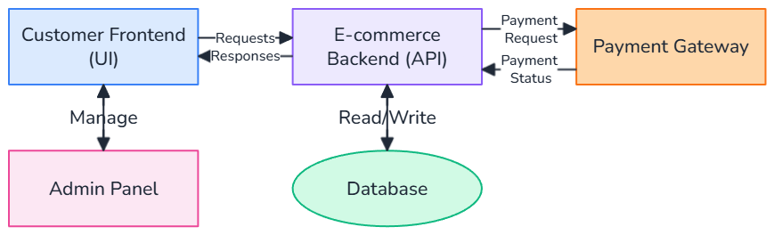
E-Commerce Framework
Horizontal framework
  Structure and responsibilities: Cross-functional, autonomous teams handle end-to-end customer journeys (browsing, cart, checkout, fulfillment) across shared services.
  Decision-making and control: Local teams own domain decisions, enabling rapid responses to daily operations and customer requests.
Vertical framework
  Structure and responsibilities: Layered roles with clear hierarchies (frontline, supervisors, managers) for each function (sales, payments, inventory, logistics).
  Decision-making and control: Centralized governance with decisions flowing upward to ensure consistency across channels and regions.

Slide 6
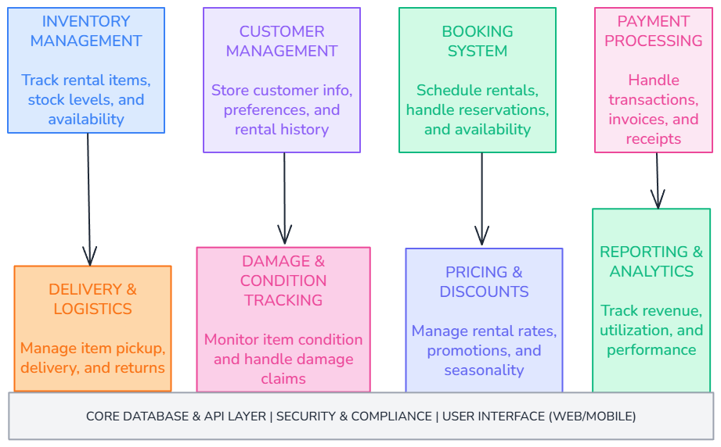
Rental Store Framework
Horizontal framework
  Structure and responsibilities: Cross-functional, autonomous teams handle end-to-end rental processes (selection, reservation, payment, pickup, returns) across shared workflows.
  Decision-making and control: Local teams own domain decisions, enabling rapid responses to daily rental operations and customer inquiries.
Vertical framework
  Structure and responsibilities: Layered roles with clear hierarchies (frontline agents, team leads, managers) for each function (booking, billing, fleet management, maintenance).
  Decision-making and control: Centralized governance with decisions flowing upward to ensure consistency across locations and channels.

Slide 7
THANK YOU

